Slide 1

cs396 senior project Cognitive model of Introverted Students in class
Daniel Kwon & Jaden Brookens
Advisor: professor E. Araújo
Agent based modeling

Slide 2
Our Goals
Build a model of the cognitive process of a student.
Predict the frequency of response from a student.
Use the model to develop refinements for classroom activities.
Notes:
computer simulations used to study the interactions between people, things, places, and time.
Netlogo is simulation tool, which is effective tool to use agent based model

Slide 3
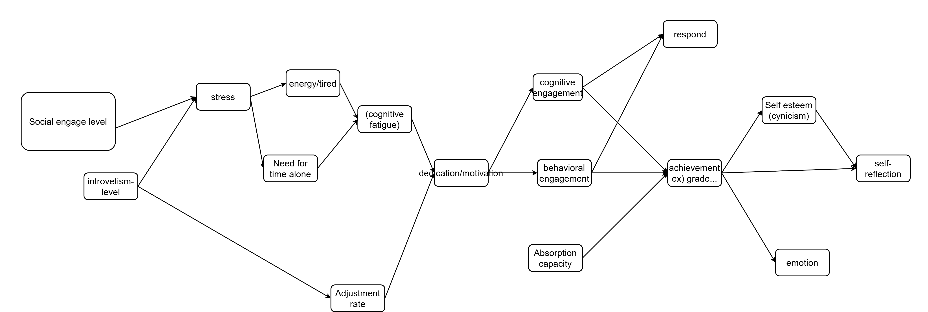
What We Have Done
Read papers about cognitive process of students.
Define what are the key features that make students respond. (Nodes)
Discuss the interactions between features. (Arrows)

Slide 4
What’s Next
Finalize our model.
Finetuning the weights and bias using machine learning skills.
Implementing in net-logo to simulate our model.

Slide 5
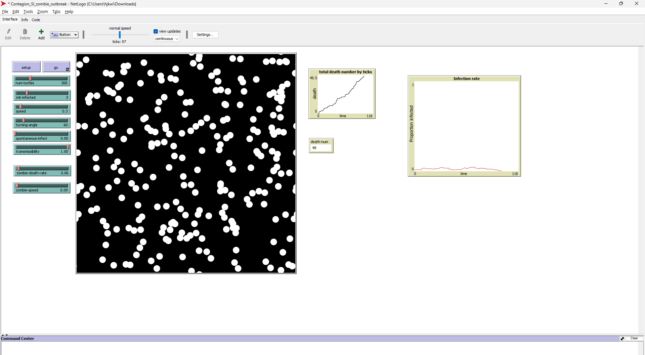

Slide 6

Thank you

